Slide 1
UCSD Embedded C Assignment 6
By
Hsuankai Chang
hsuankac@umich.edu

Slide 2
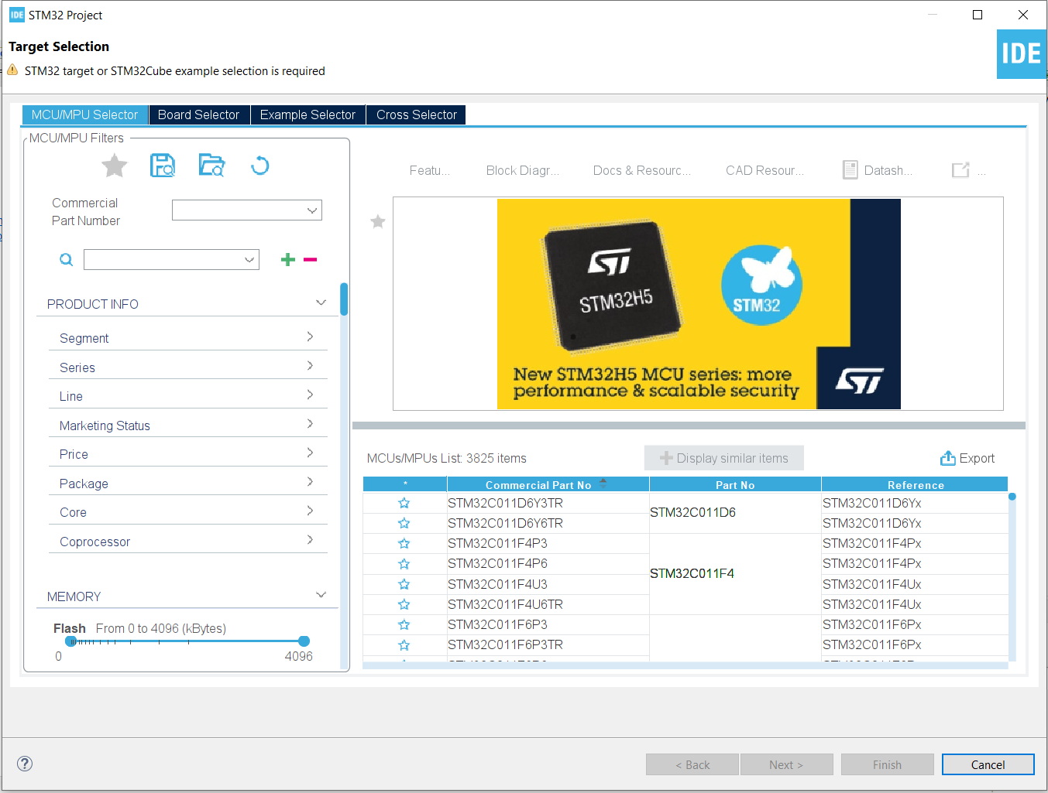
Step 1. Startup STM32CubeIDE and create new STM32 project

Slide 3
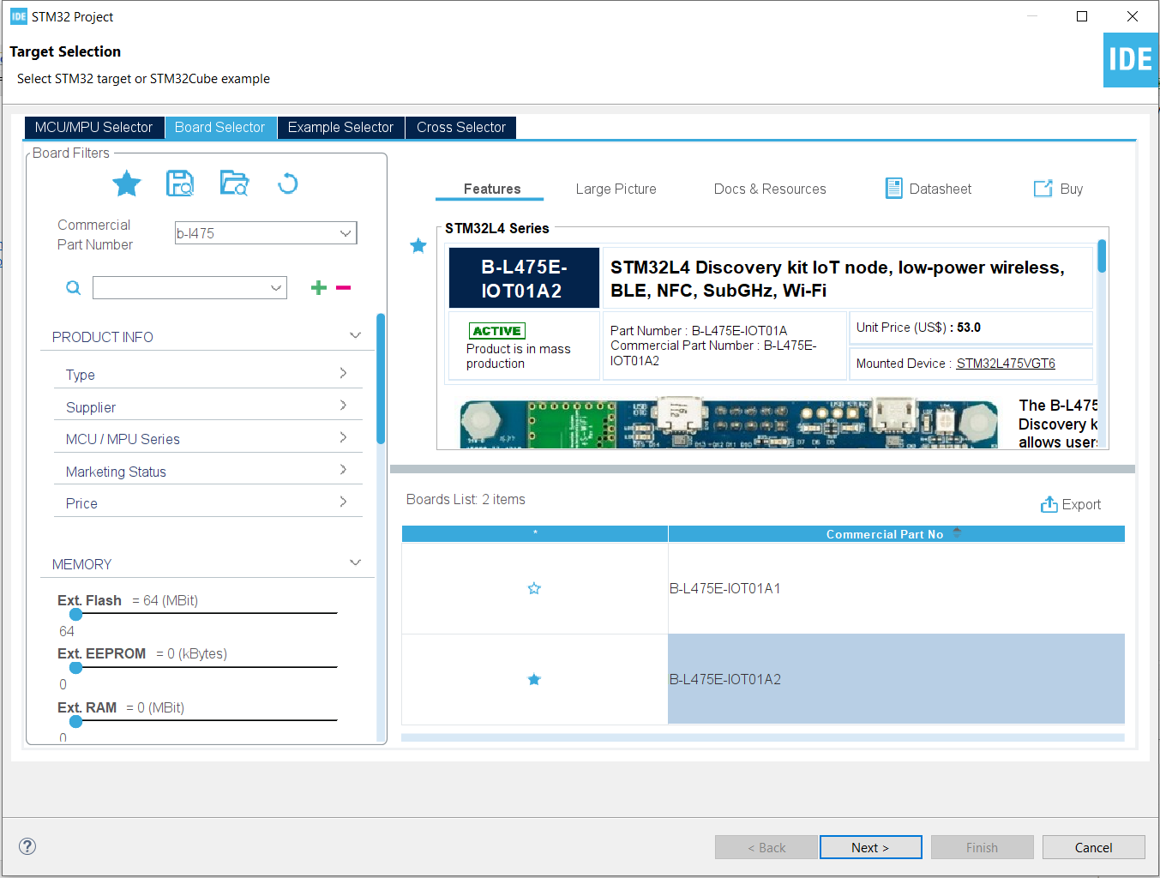
Step 2. Access board selector and type in the board you use, click Next

Slide 4
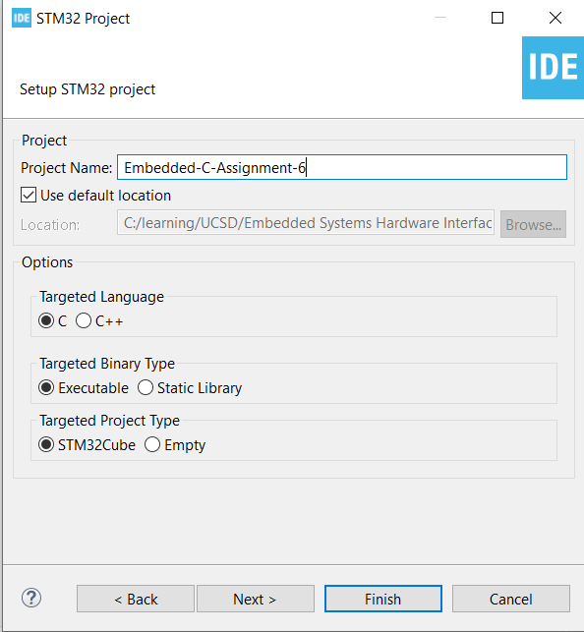
Step 3. Enter the project name then click Next

Slide 5
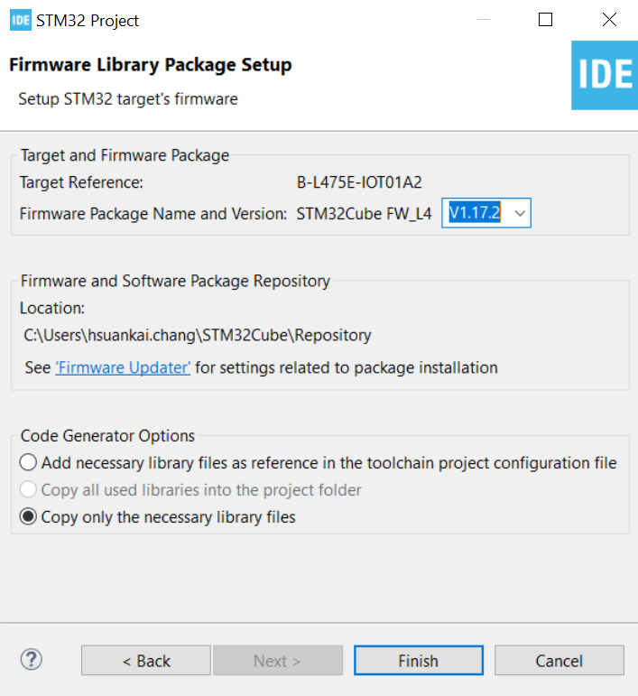
Step 4. See the firmware package name and version

Slide 6
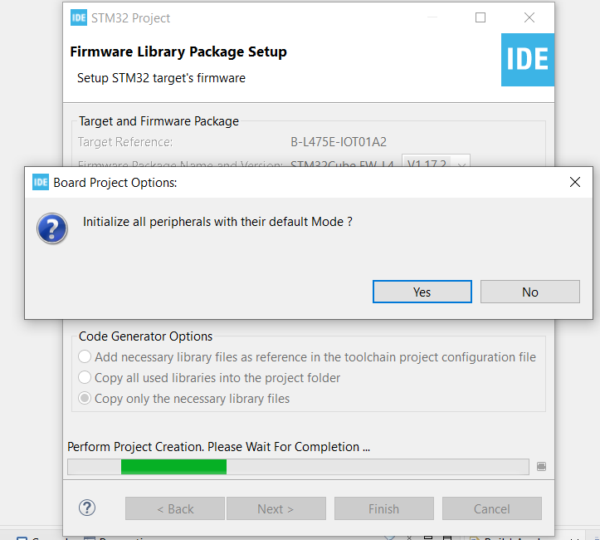
Step 5. Click yes to initialize all peripherals to default

Slide 7
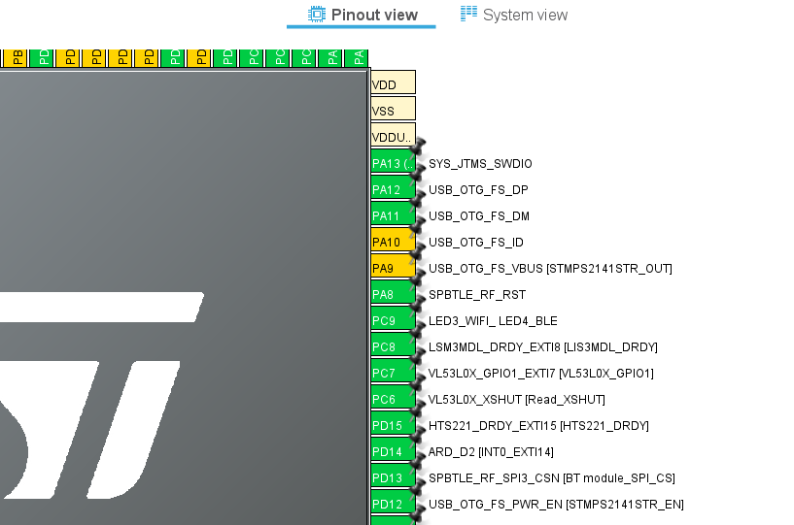
Step 6. When in .ioc file, keep defaults USB OTG settings

Slide 8
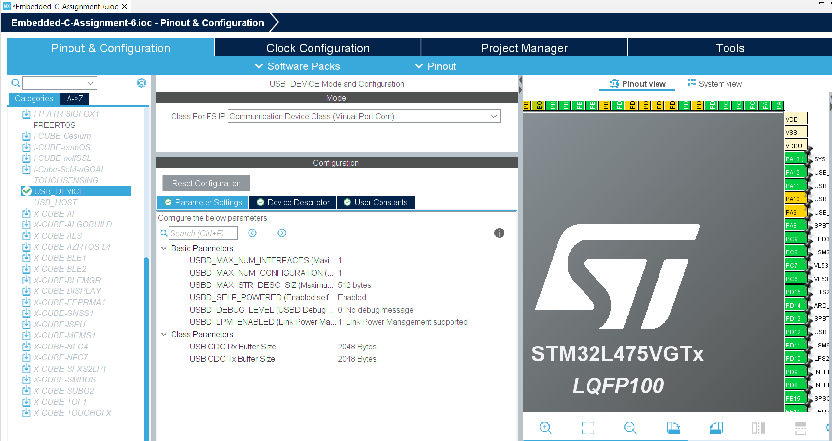
Step 7. Add middleware for virtual COM port, and use the default parameter settings

Slide 9
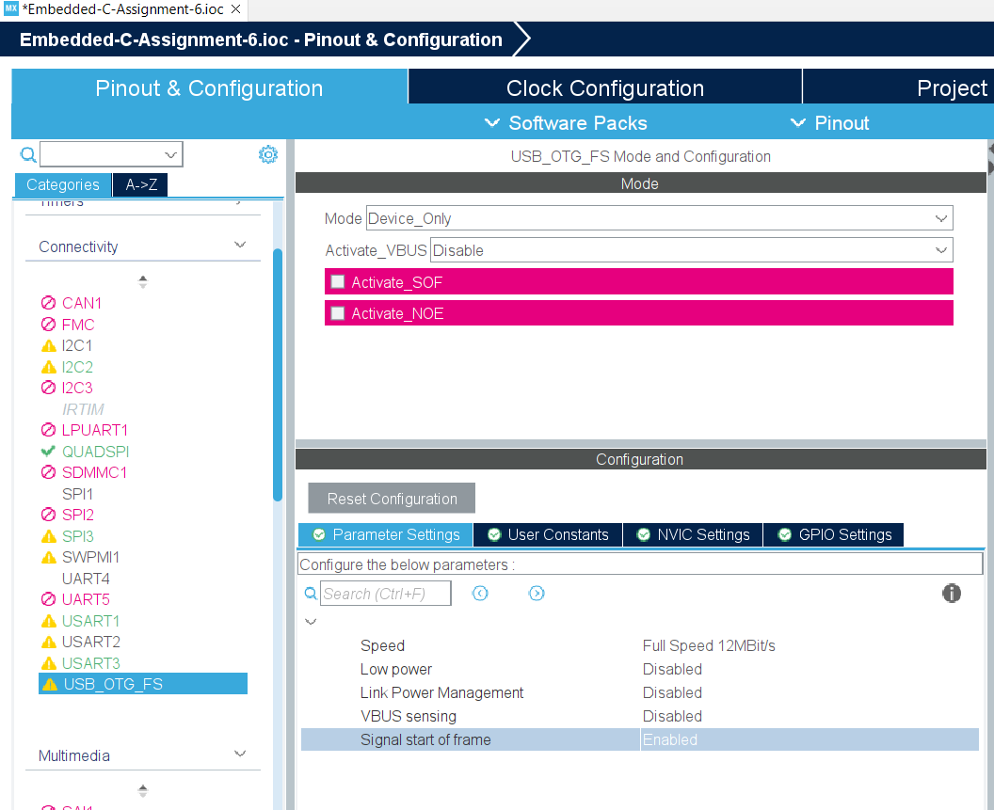
Step 8. Connectivity - USB_OTG_FS -Signal Start of Frame - Enabled

Slide 10
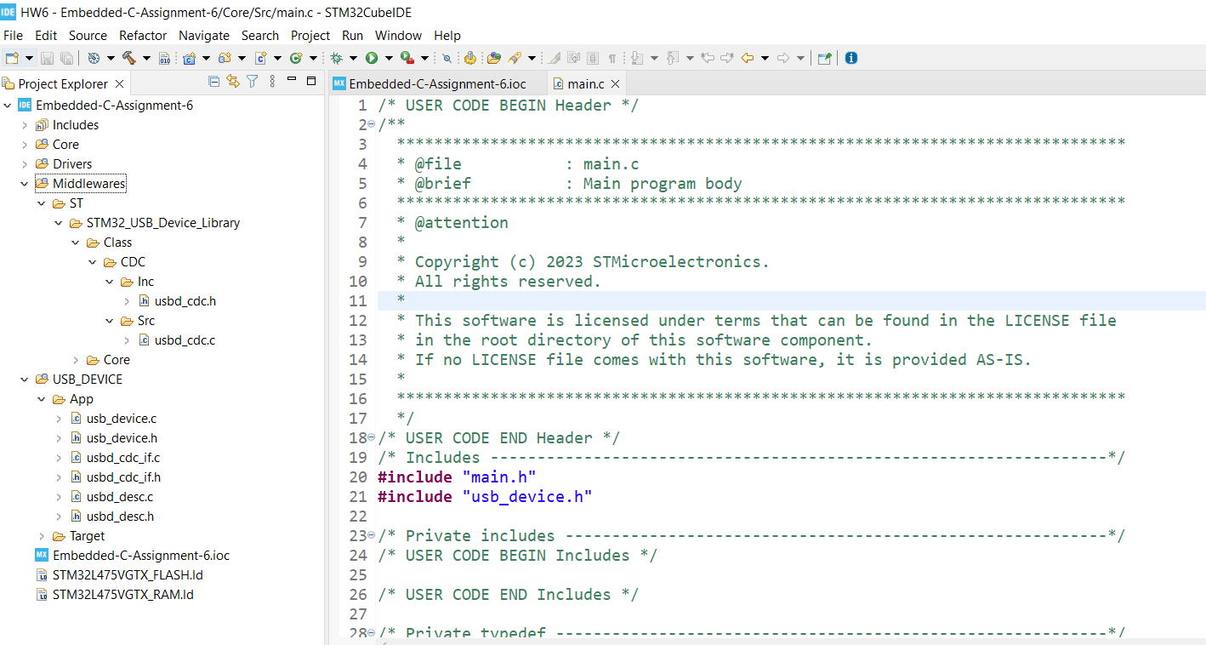
Step 9. Result of code generation

Slide 11
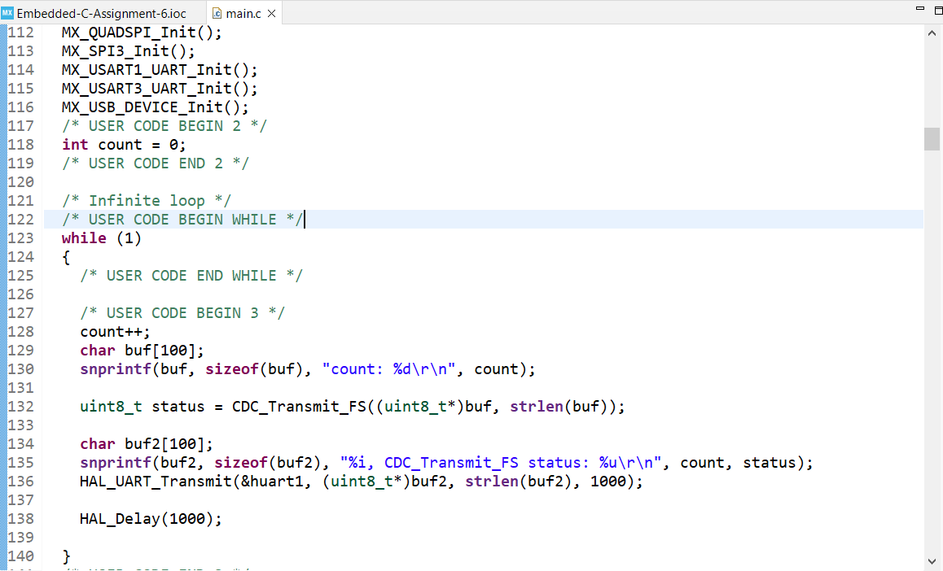
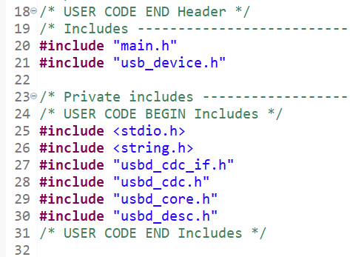
Step 10. Add code to main.c file

Slide 12
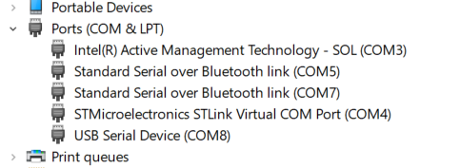
Step 11. Build and run the code, see a new COM port appear

Slide 13
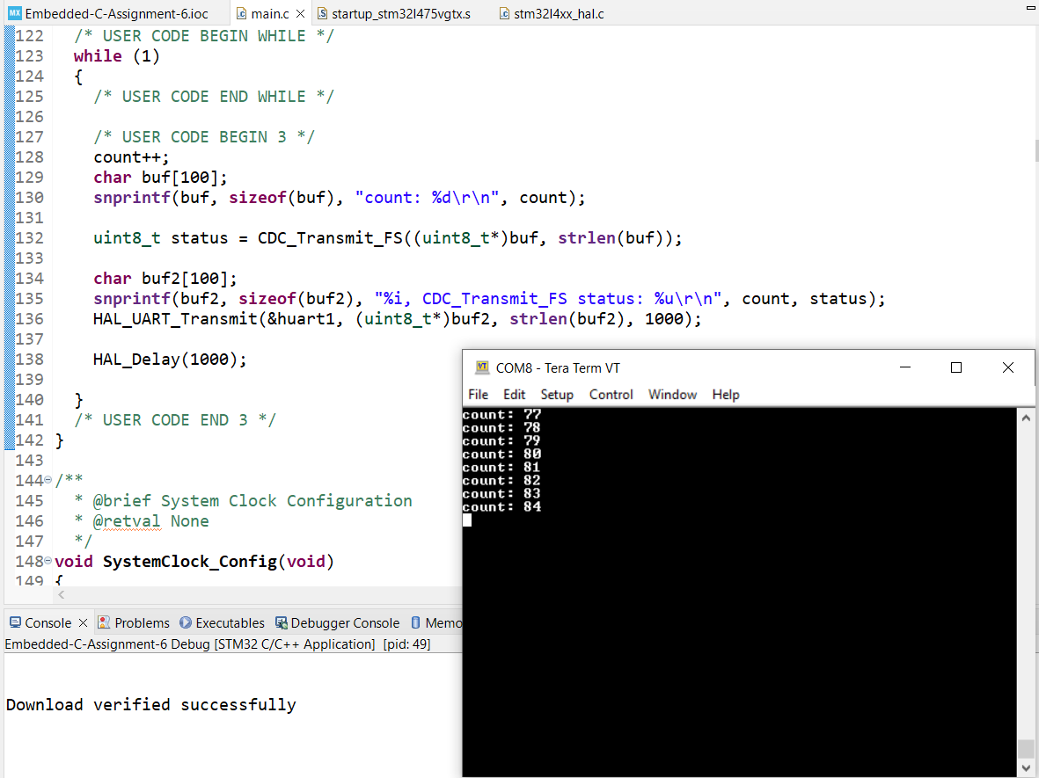
Step 12. Test on the new COM port, Tx is successful

Slide 14
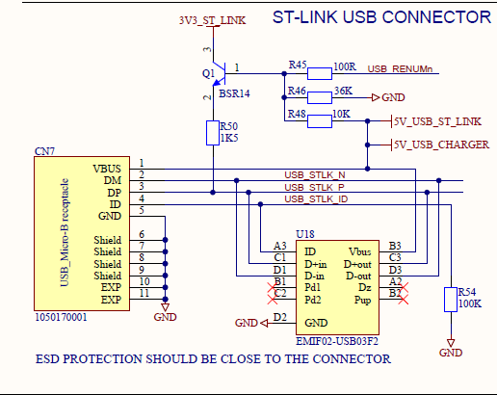
Appendix, schematic for ST-LINK USB Connector

Slide 15
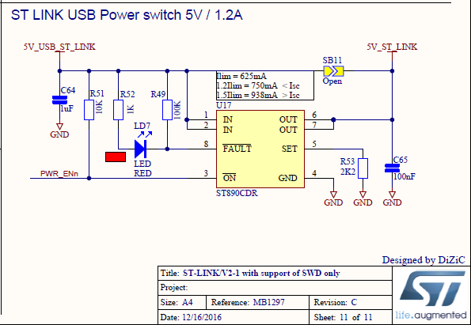
Appendix, schematic for ST-LINK Power Switch

Slide 16
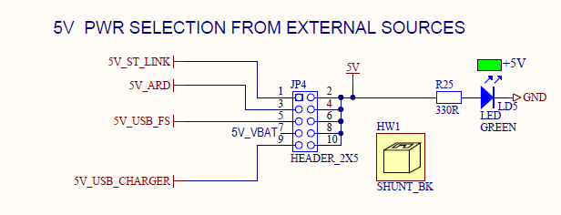
Appendix, schematic for 5V PWR SELECTION

Slide 17
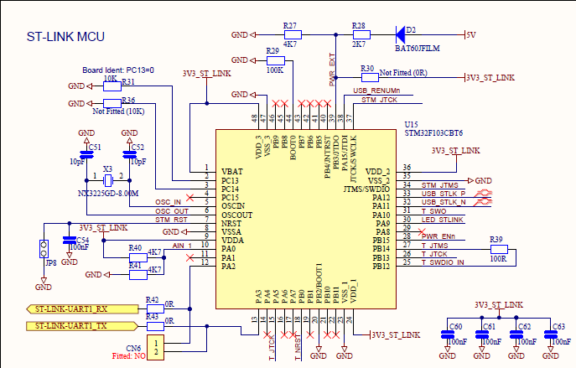
Appendix, schematic for ST-LINK MCU

Slide 18
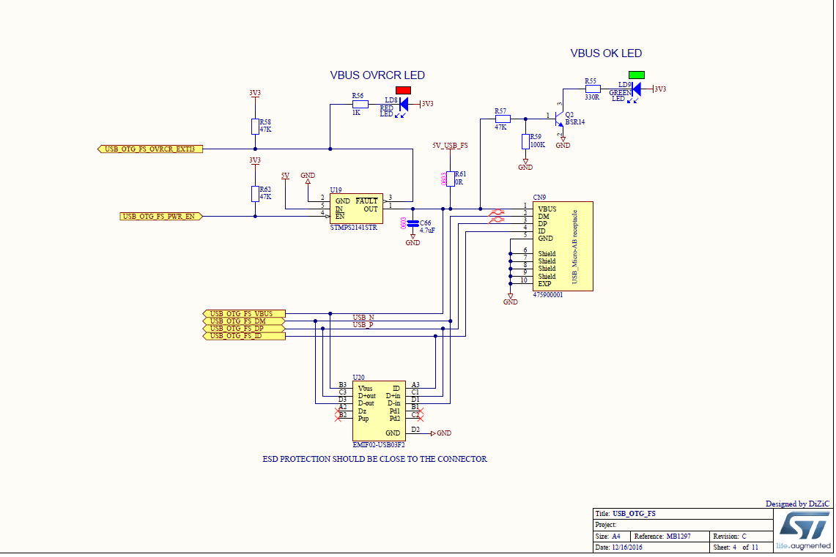
Appendix, schematic for USB_OTG_FS

